Slide 1
Interactive Shiny App for Comparative Analysis of Circadian Activity in Mosquito species Using LAM Data
By: Gavin Geddes

Slide 2
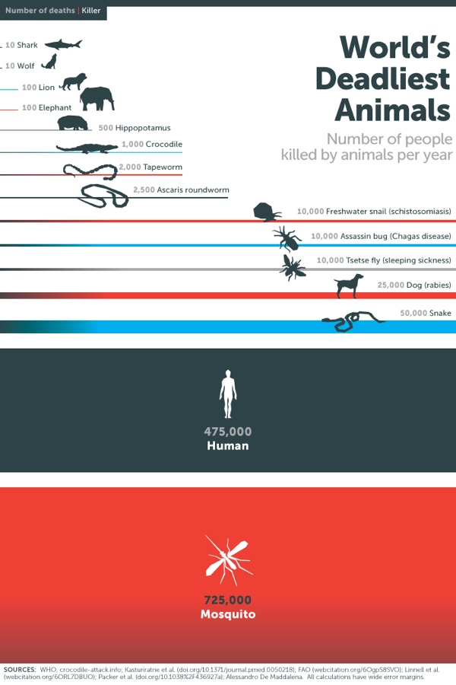
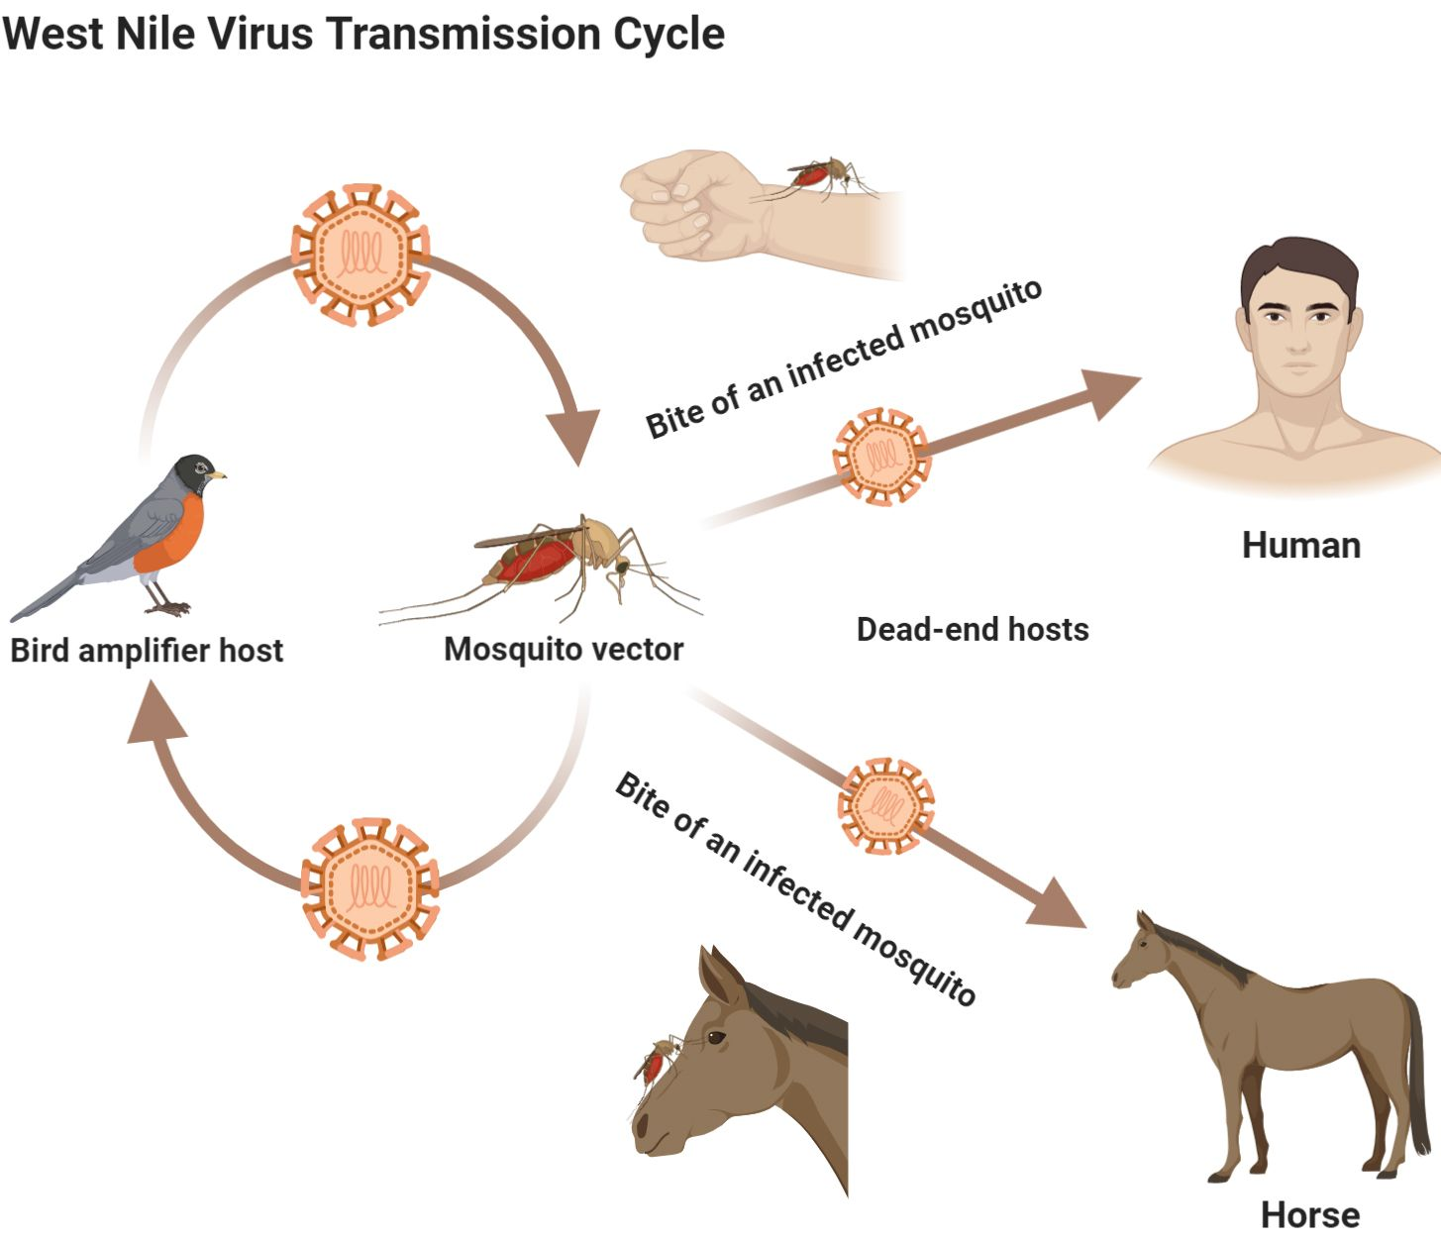
Burkett-Cadena ND et. al (2013)

Slide 3
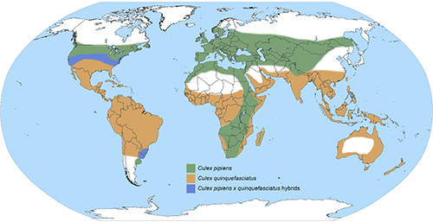
Global distribution of Culex mosquitoes
Mosquitoes tune time-of-day specific behavior to seasonal change in photoperiod
Research Question: How do activity patterns differ between mosquito species within the Culex pipiens Complex?
Culex pipiens
Culex quenquefasciatus
Culex pipiens x Culex quenquefasciatus hybrids
Burkett-Cadena ND et. al (2013)

Slide 4
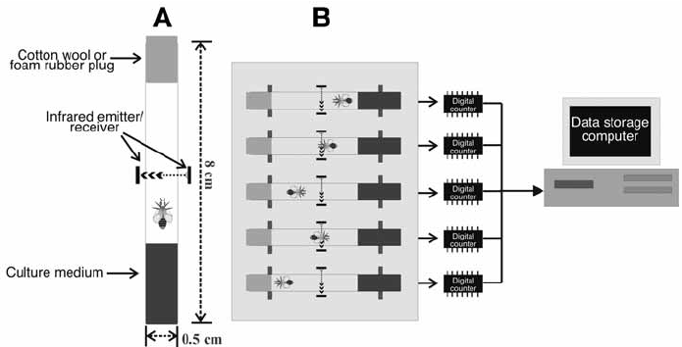
How can activity be quantified?

Slide 5
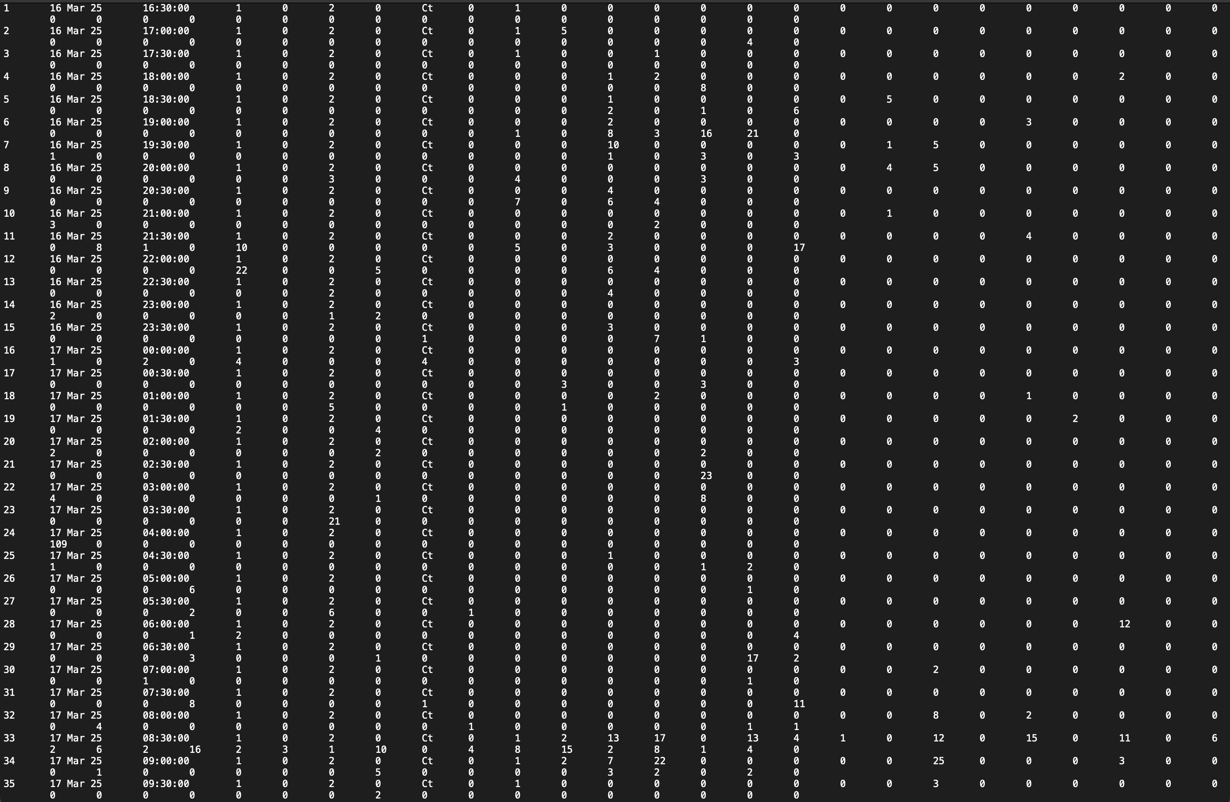
Can the development of a dynamic tool to aid in identifying species-specific differences in activity patterns?

Slide 6
R Packages
shiny → Tools to build interactive web application in R
tidyverse → Simplifies data wrangling, visualization & manipulation
lubridate → Works with date & time data, easier to parse, manipulate & extract components (hrs, days, etc)
shinythemes → Adds pre-made UI themes for Shiny apps
DT → Wraps JavaScript DataTables library for use in shiny. Enables interactive tables
ggplot2 → graphics package within tidyverse

Slide 7
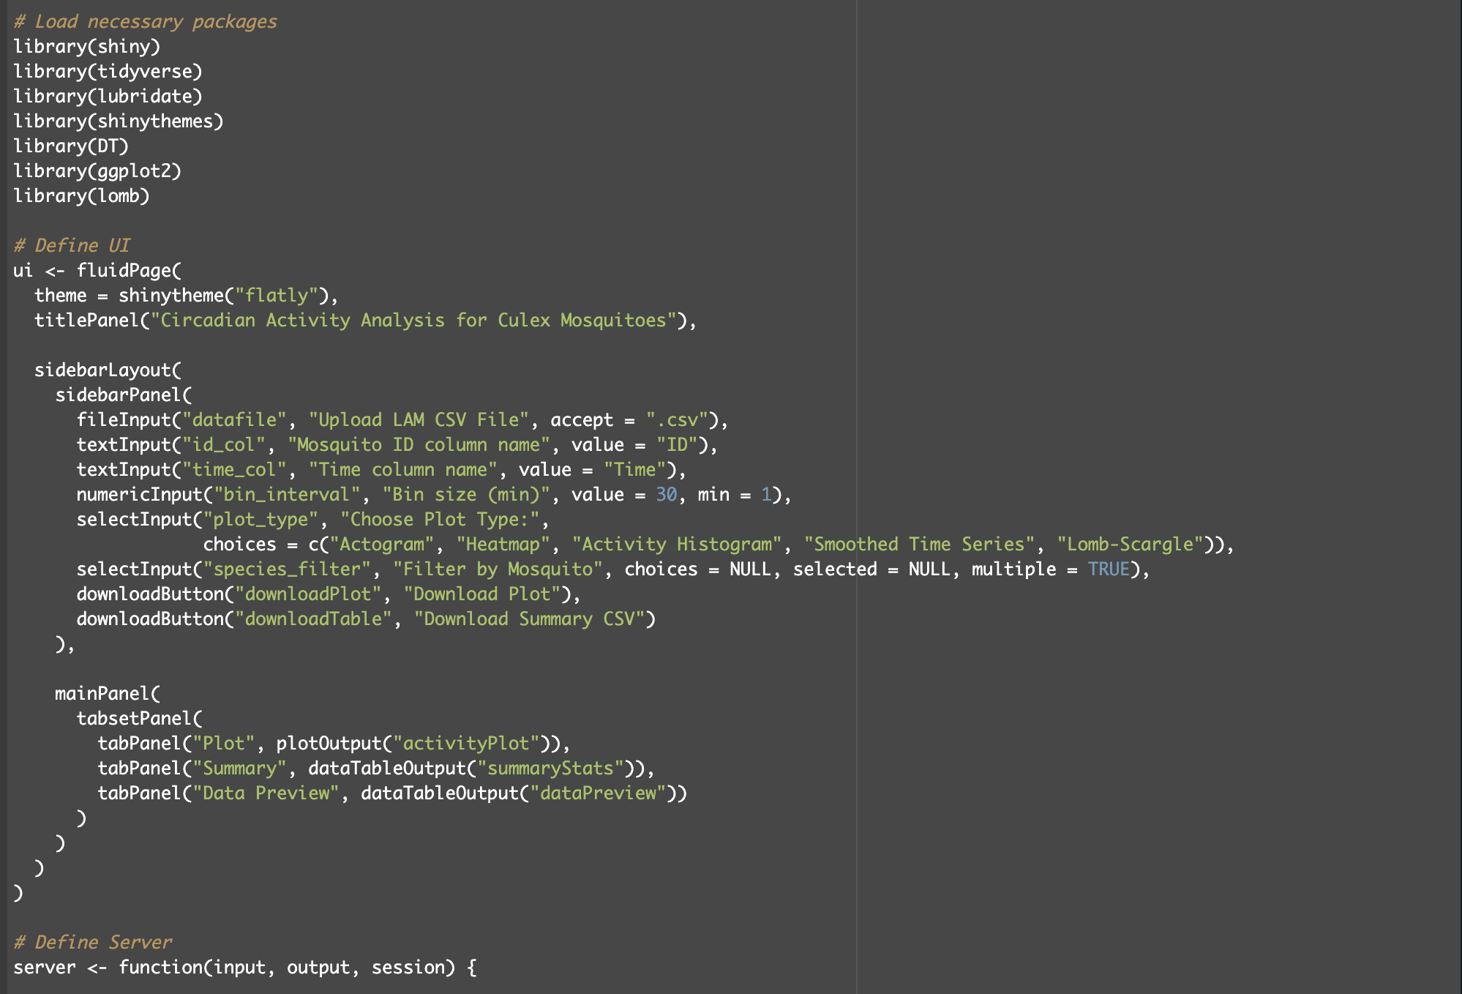

Slide 8
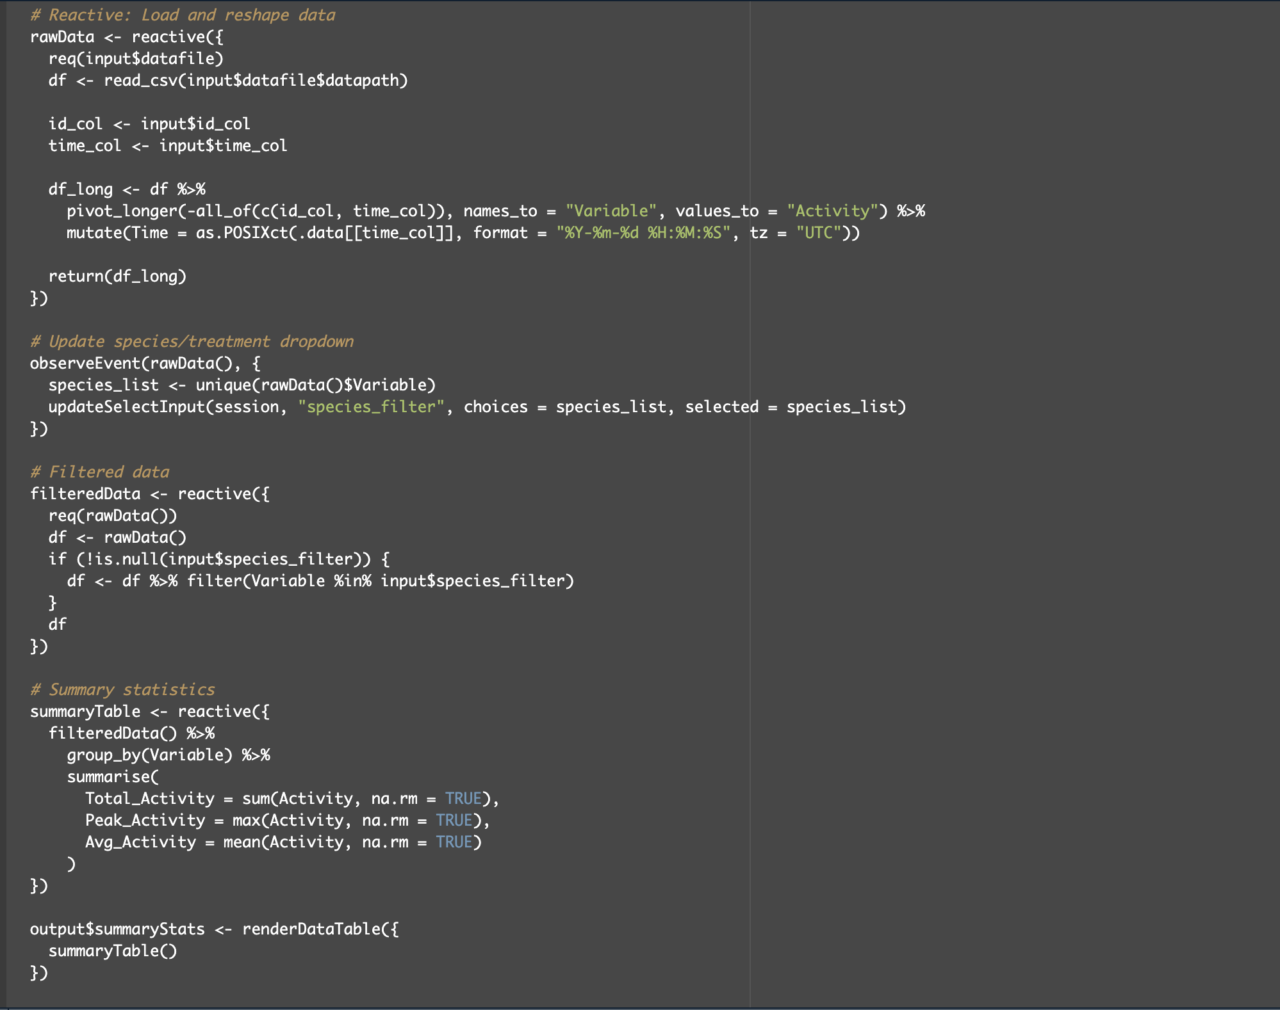

Slide 9
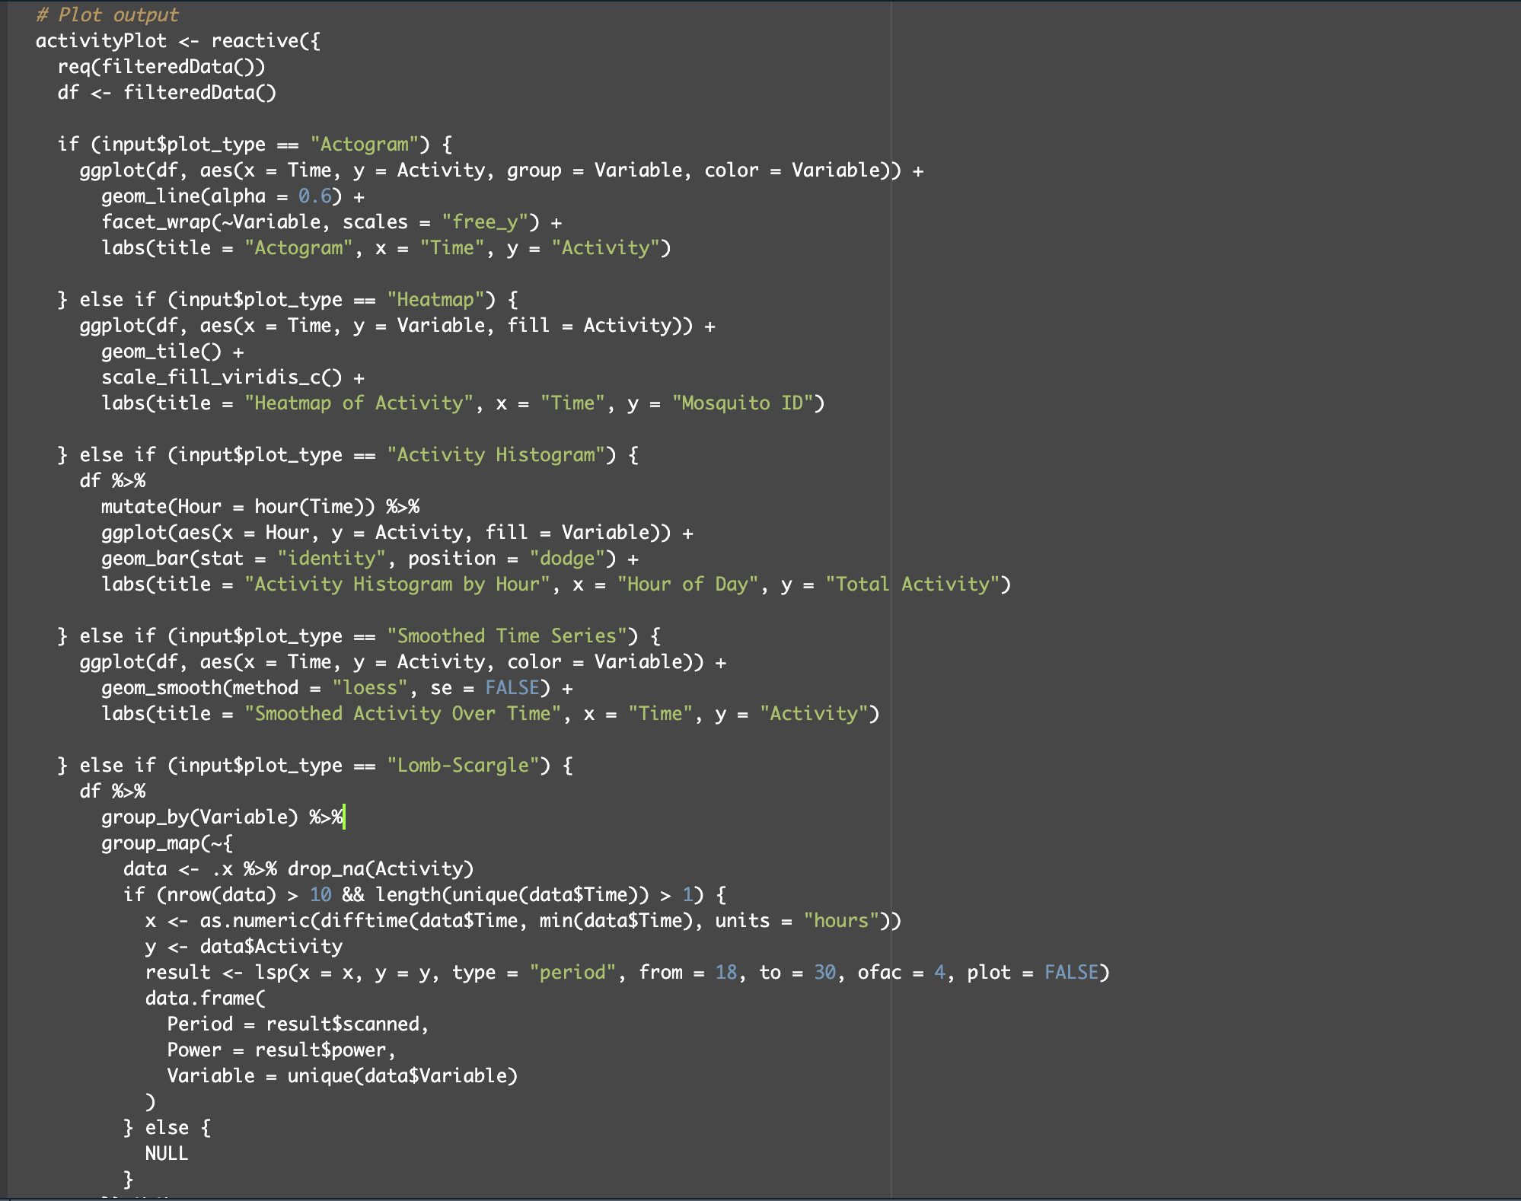

Slide 10
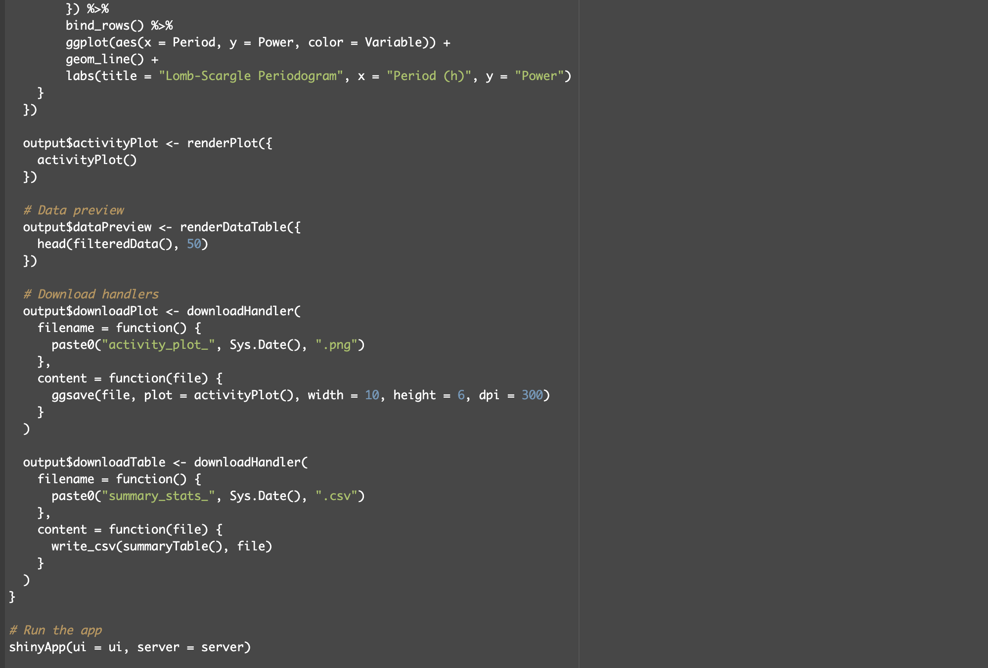

Slide 11
Code Block Overview
shinyApp (ui, server):
Core wrapper for the whole application
UI: User Interface Design
Controls layout and visible elements
Key components:
Fileinput() → upload user LAM data
Textinput() / numericInput() → define parameters
Selectinput() → choose plot type, filter mosquitoes
tabsetPanel() → organize plots/tables in tabs
Server: Functional Logic (Responds to user input & output)
rawData → Loads, reshapes, & formats uploaded data
observeEvent() → Updates dropdown filters based on uploaded file
summaryTable → Computes total, peek, & average activity
activityPlot → Generates user-selected plot types:
Actogram
Heatmap
Activity Histogram
Smoothed Time Series

Slide 12
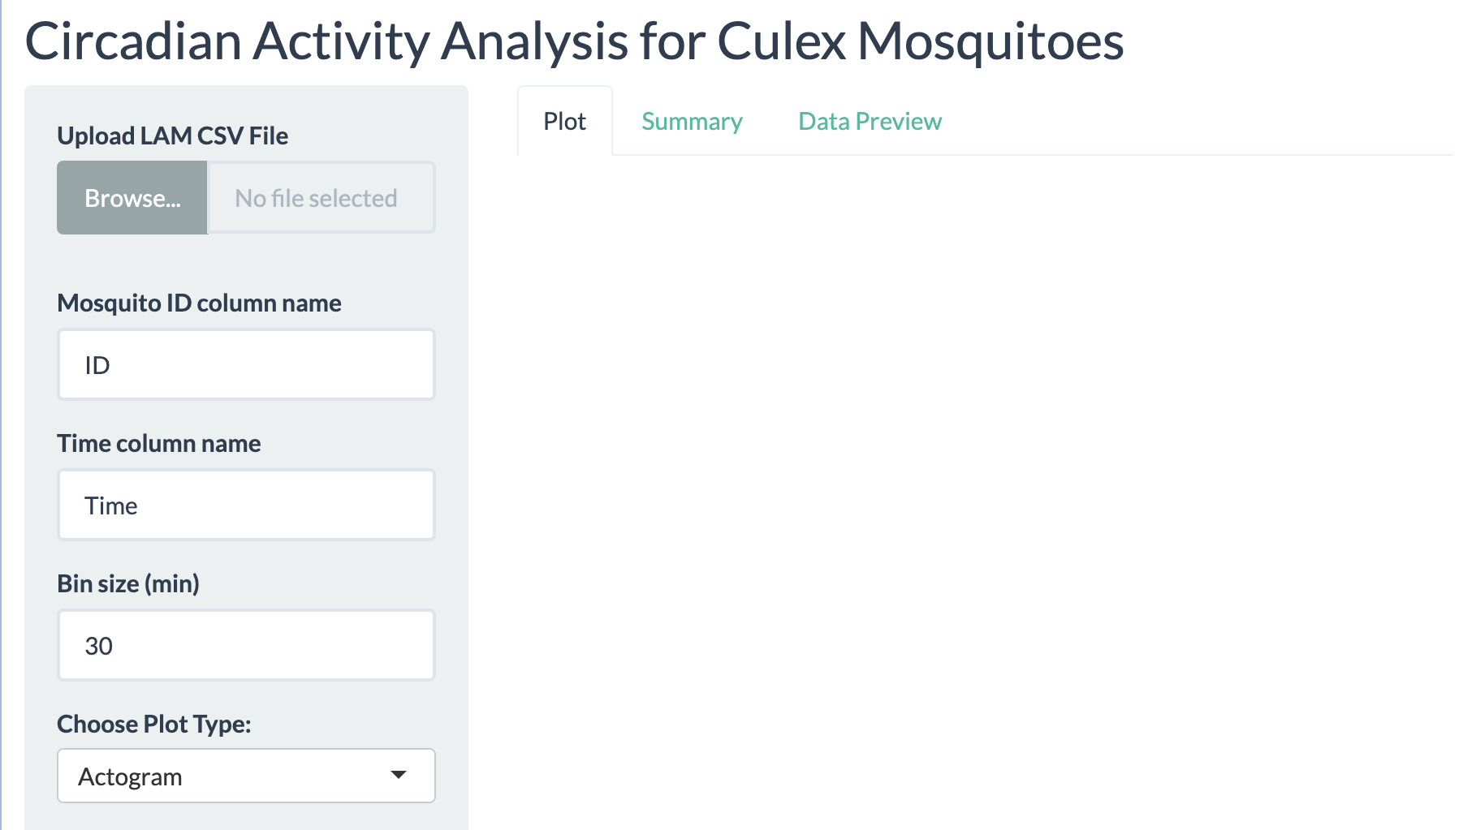

Slide 13
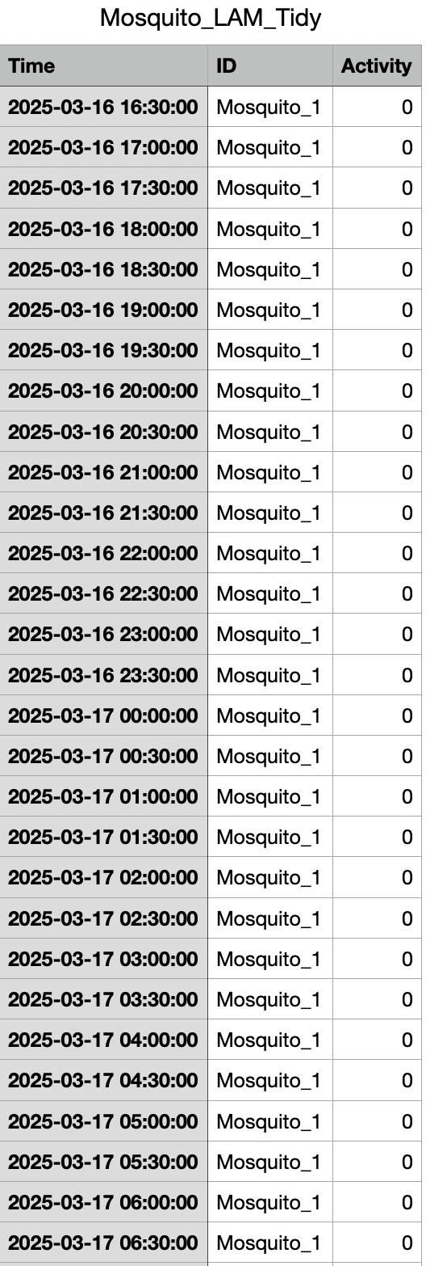
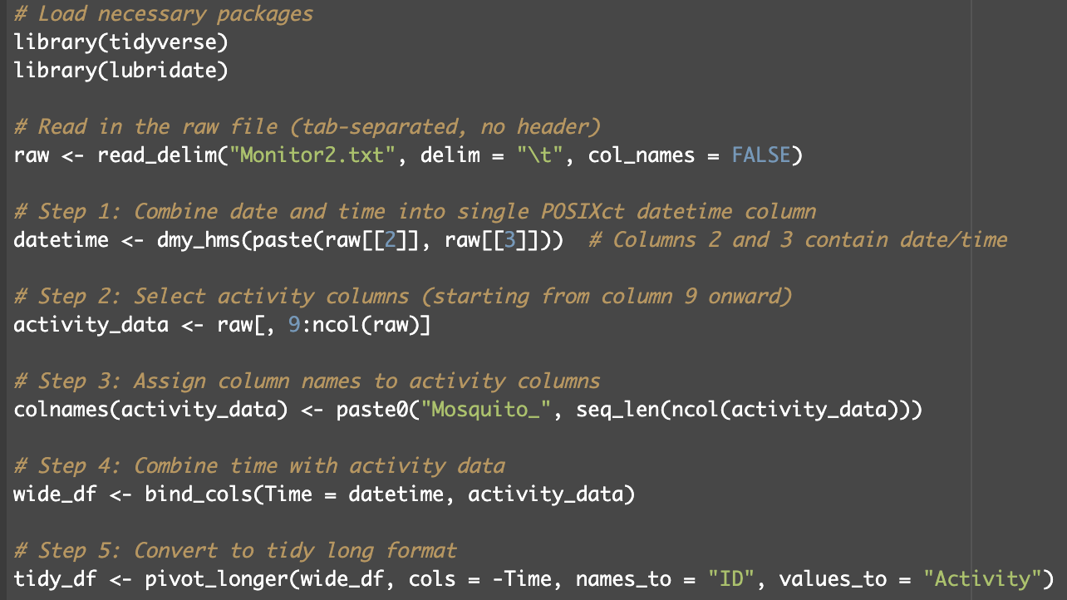

Slide 14
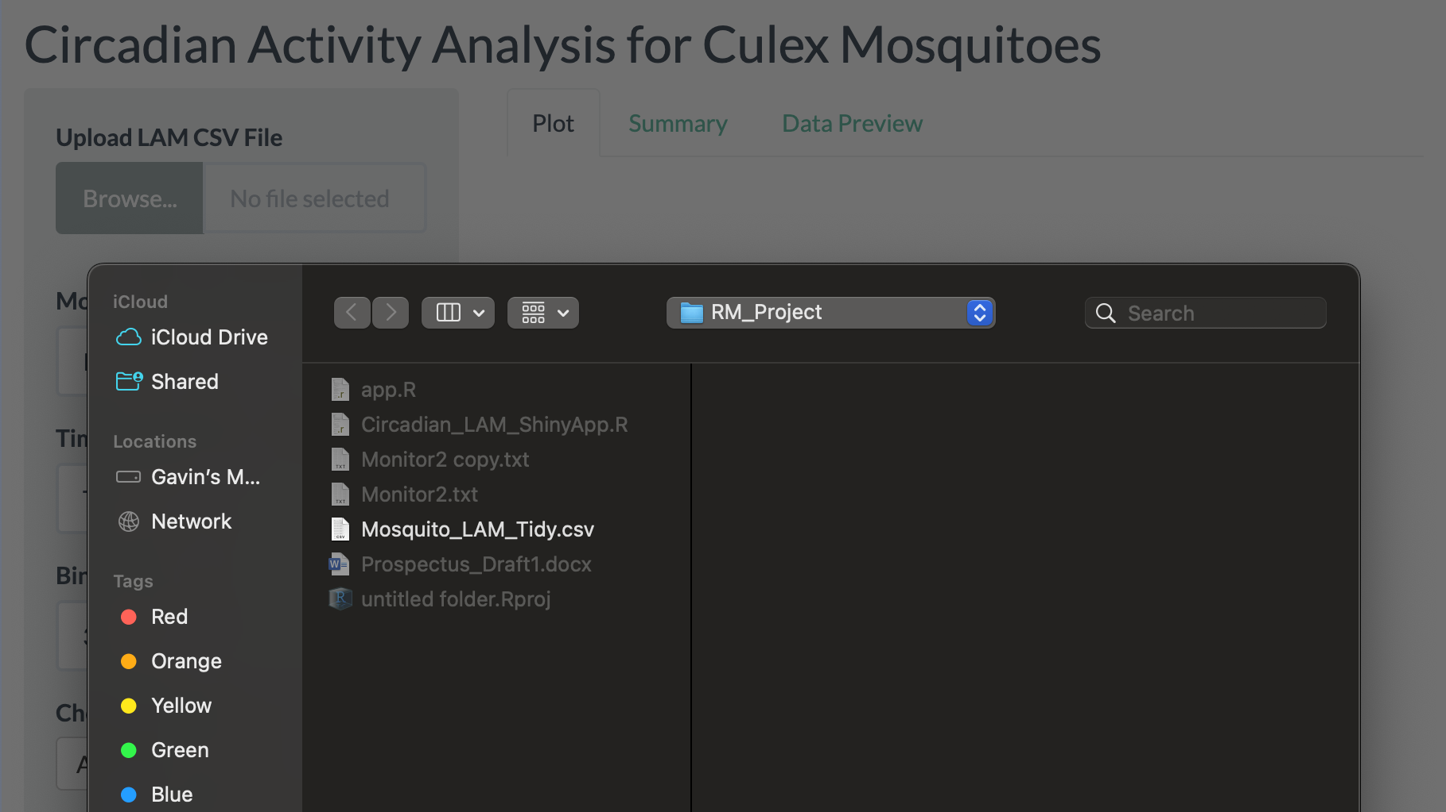

Slide 15
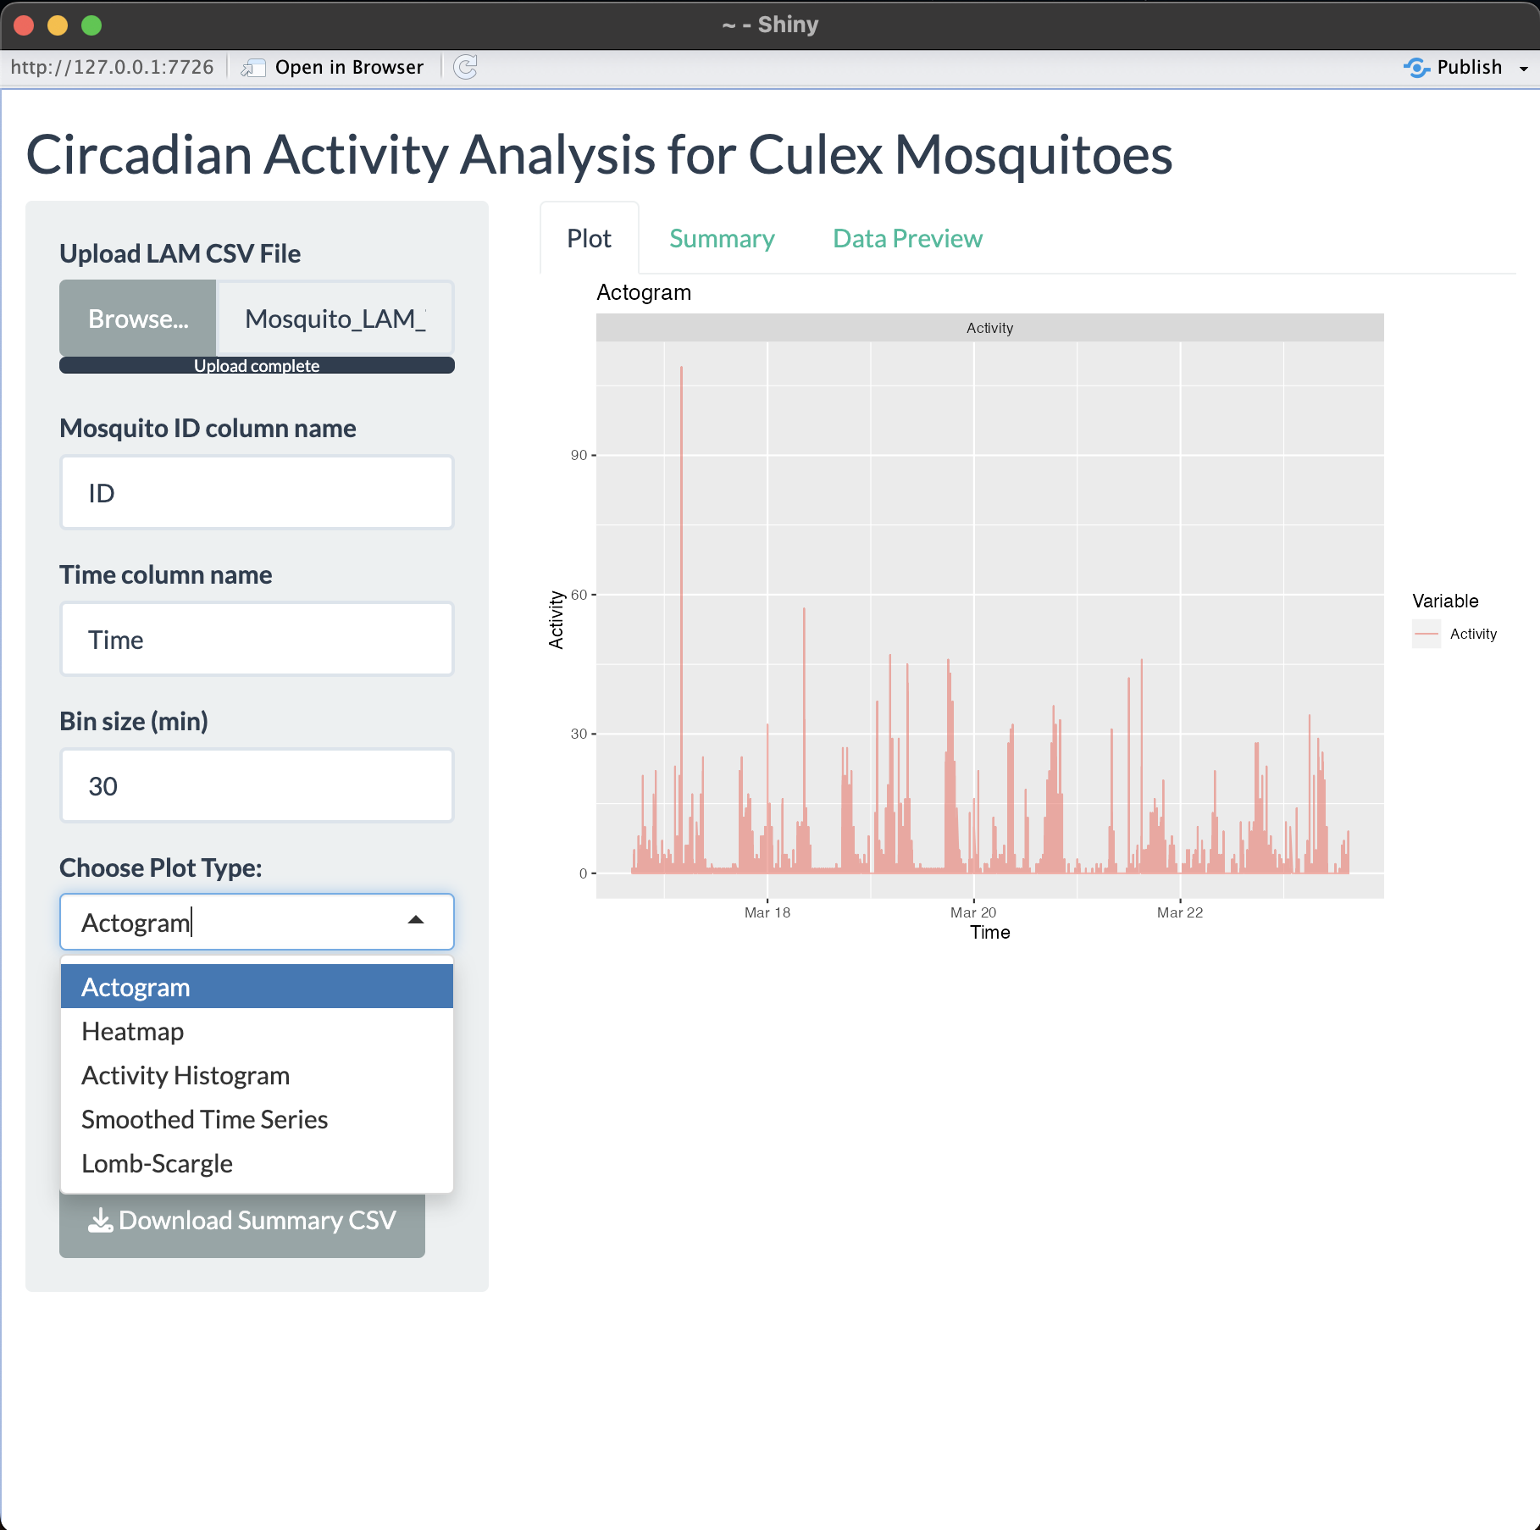
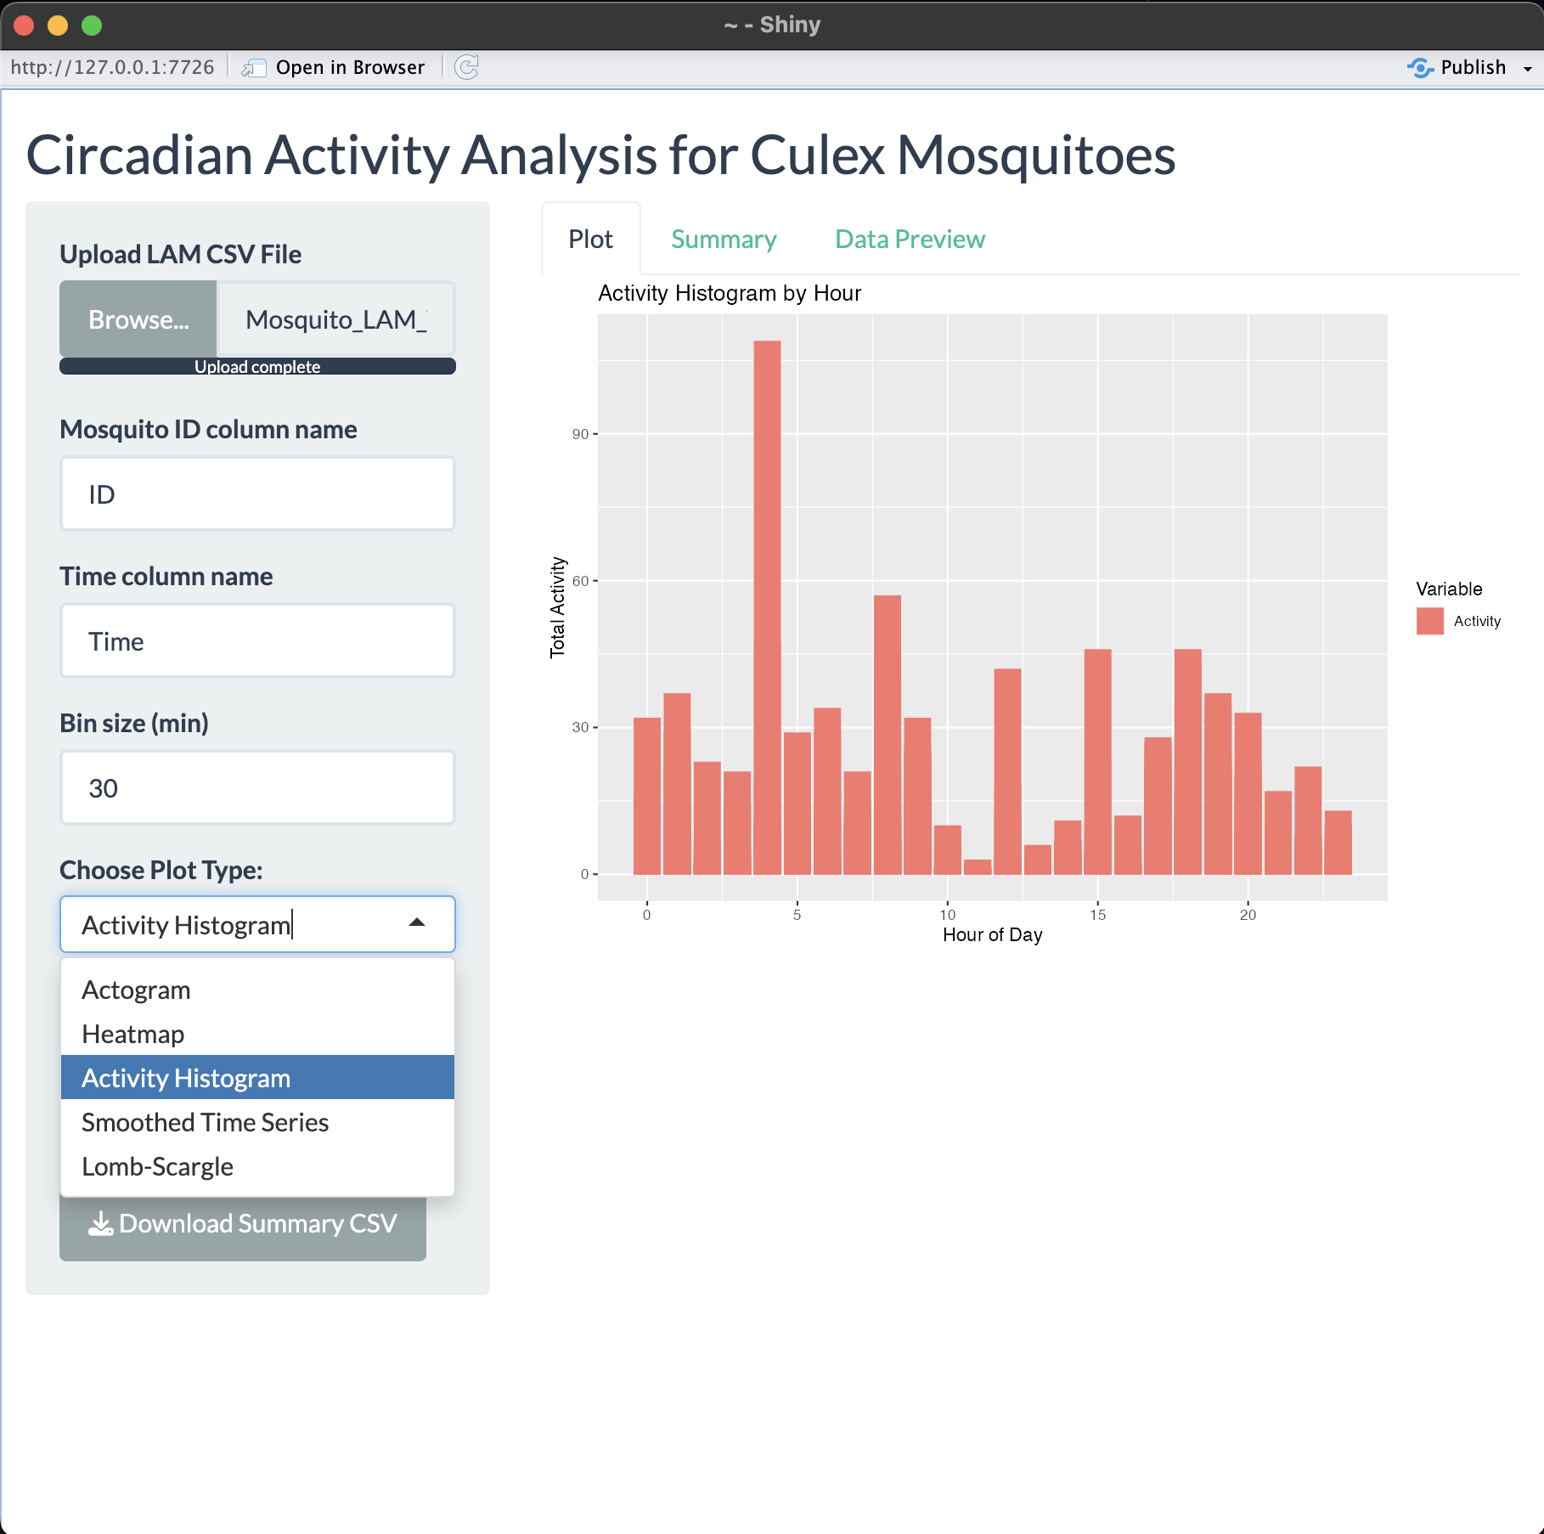

Slide 16
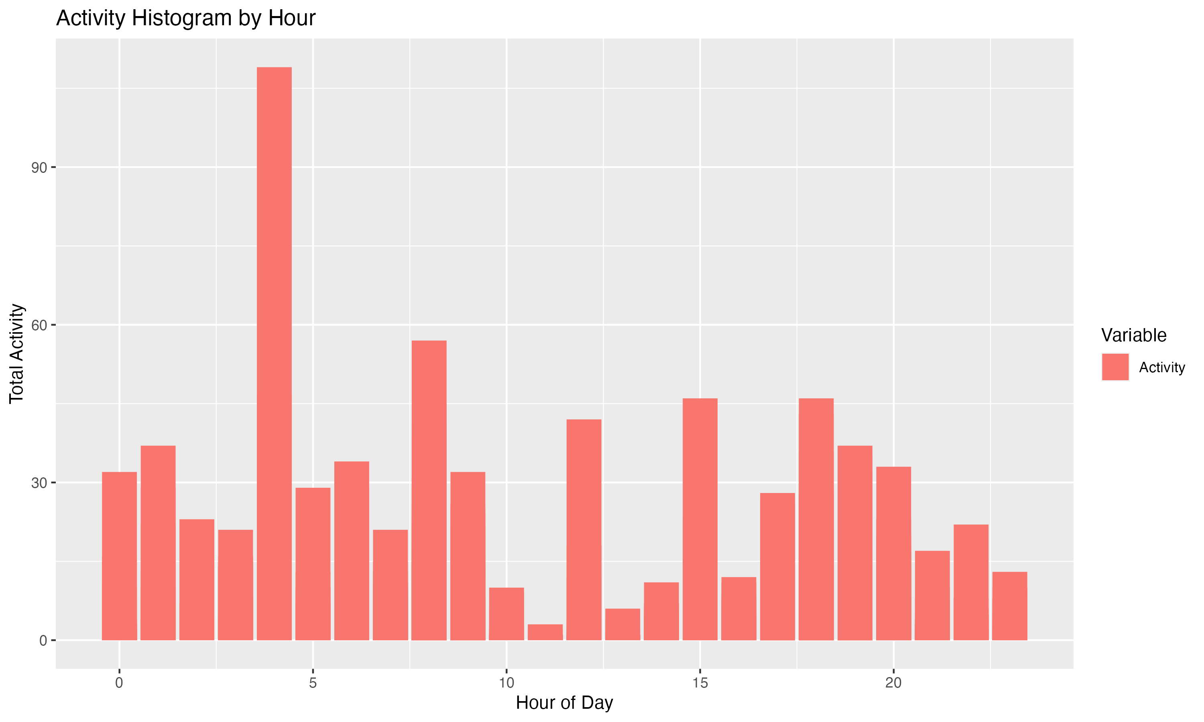

Slide 17
Conclusion
Streamlines process from data collection to publishable figures
Informs agencies on seasonal time-of-day activity patterns of clinically significant mosquito populations

Slide 18
References
Clements, A. N. (1999). The Biology of Mosquitoes: Sensory Reception and Behaviour. CABI
Publishing.
Rosato, E., & Kyriacou, C. P. (2006). Analysis of locomotor activity rhythms
in Drosophila. Nature Protocols, 1(2), 559–568. https://doi.org/10.1038/nprot.2006.79
Wickham, H. (2016). ggplot2: Elegant Graphics for Data Analysis. Springer.
Merow, C., Serra-Diaz, J. M., Enquist, B. J., & Wilson, A. M. (2023). AI chatbots can boost
scientific coding. Nature Ecology & Evolution, 7(7), 960–
962. https://doi.org/10.1038/s41559-023-02063-3
Meuti, M. E., Stone, M., Ikeno, T., & Denlinger, D. L. (2015). Functional circadian clock genes are essential
for the overwintering diapause of the Northern house mosquito, Culex pipiens. The Journal of
Experimental Biology, 218(Pt 3), 412–422. https://doi.org/10.1242/jeb.113233
Chang, V., & Meuti, M. E. (2020). Circadian transcription factors differentially regulate features of the adult
overwintering diapause in the Northern house mosquito, Culex pipiens. Insect Biochemistry and
Molecular Biology, 121, 103365. https://doi.org/10.1016/j.ibmb.2020.103365

Slide 19
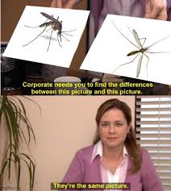
Questions?

